Slide 1


Introduction to Microprocessors & Microcontrollers
Presented by
Mahbubur Rahman
Lecturer
Department of Computer Science and Engineering(CSE)
Green University of Bangladesh(GUB)

Slide 2
Microprocessor
Microprocessor is a programmable device
It can be instructed to perform given tasks within its capability.
The programmer selects instruction from the list and determines the sequence of execution for a given task.
It takes input from the input device and process the input as it behaves like a CPU and gives the output.
Microprocessor can be divided into three segments – ALU, Register Array, Control Unit.

Slide 3
Characteristics which differentiate Microprocessors
Instruction Set: The set of instructions that the microprocessor can execute.
Bandwidth: The number of bits processed in a single instruction.
Clock Speed: Given in (MHz), the clock speed determines how many instructions per second the processor can execute.

Slide 4
What is the difference between microprocessor, microcontroller and microcomputer?
A Microcontroller is a Microcomputer with memory and I/O integrated into one chip.
The Microcomputer is a Microprocessor with added memory and input/output
The Microprocessor contains the CPU, the ALU and the control units, with partial memory and I/O configuration.
What is a bit, byte, nibble and a word?
Eight bits represent a character and is called a byte. Nibble: A nibble is a combination of four bits, in other words a nibble is half a byte. Word: a word is a combination of 16 bits, 32 bits or 64 bits depending on the computer.

Slide 5
What is Mnemonics?
Assembly language is the symbolic form of machine language. Assembly programs are written with short abbreviations called mnemonics.
Assembly language uses a mnemonic to represent each low-level machine instruction or opcode.
Mnemonic is anything (especially something in verbal form) used to help remember something while opcode is (computing) a mnemonic used to refer to a microprocessor instruction in assembly language.

Slide 6
The 8085 Microprocessor
8085 is pronounced as "eighty-eighty-five" microprocessor. It is an 8-bit microprocessor designed by Intel in 1977 using NMOS technology.
It has the following configuration −
8-bit data bus
16-bit address bus, which can address up to 64KB
A 16-bit program counter
A 16-bit stack pointer
Six 8-bit registers arranged in pairs: BC, DE, HL
Requires +5V supply to operate at 3.2 MHZ single phase clock
It is used in washing machines, microwave ovens, mobile phones, etc.

Slide 7
8085 Microprocessor – Functional Units
8085 consists of the following functional units −
Accumulator
It is an 8-bit register used to perform arithmetic, logical, I/O & LOAD/STORE operations. It is connected to internal data bus & ALU.
Arithmetic and logic unit
As the name suggests, it performs arithmetic and logical operations like Addition, Subtraction, AND, OR, etc. on 8-bit data.
General purpose register
There are 6 general purpose registers in 8085 processor, i.e. B, C, D, E, H & L. Each register can hold 8-bit data.
These registers can work in pair to hold 16-bit data and their pairing combination is like B-C, D-E & H-L.

Slide 8
8085 Microprocessor – Functional Units (Cont.)
Program counter
It is a 16-bit register used to store the memory address location of the next instruction to be executed. Microprocessor increments the program whenever an instruction is being executed, so that the program counter points to the memory address of the next instruction that is going to be executed.
Stack pointer
It is also a 16-bit register works like stack, which is always incremented/decremented by 2 during push & pop operations.
Temporary register
It is an 8-bit register, which holds the temporary data of arithmetic and logical operations.

Slide 9
Flag register
It is an 8-bit register having five 1-bit flip-flops, which holds either 0 or 1 depending upon the result stored in the accumulator.
These are the set of 5 flip-flops −
Sign (S) – Set if the most significant bit of the result is set.
Zero (Z) – Set if the result is zero.
Auxiliary Carry (AC) – Set if there was a carry out from the bit 3 to the bit 4 of the result and this is used in BCD arithmetic.
Parity (P) – Set if the parity (the number of set bits in the result) is even.
Carry (C) – Set if there was a carry during addition, or borrow during subtraction/comparison.
Its bit position is shown in the following table −
D7 | D6 | D5 | D4 | D3 | D2 | D1 | D0
S | Z |  | AC |  | P |  | CY

Slide 10
8085 Microprocessor – Functional Units (Cont.)
Instruction register and decoder
It is an 8-bit register. When an instruction is fetched from memory then it is stored in the Instruction register. Instruction decoder decodes the information present in the Instruction register.
Timing and control unit
It provides timing and control signal to the microprocessor to perform operations. Following are the timing and control signals, which control external and internal circuits −
Control Signals: READY, RD’, WR’, ALE
Status Signals: S0, S1, IO/M’
DMA Signals: HOLD, HLDA
RESET Signals: RESET IN, RESET OUT

Slide 11
8085 Microprocessor – Functional Units (Cont.)
Interrupt control
As the name suggests it controls the interrupts during a process. When a microprocessor is executing a main program and whenever an interrupt occurs, the microprocessor shifts the control from the main program to process the incoming request. After the request is completed, the control goes back to the main program.
There are 5 interrupt signals in 8085 microprocessor: INTR, RST 7.5, RST 6.5, RST 5.5, TRAP.
Serial Input/output control
It controls the serial data communication by using these two instructions: SID (Serial input data) and SOD (Serial output data).

Slide 12
8085 Microprocessor – Functional Units (Cont.)
Address buffer and address-data buffer
The content stored in the stack pointer and program counter is loaded into the address buffer and address-data buffer to communicate with the CPU. The memory and I/O chips are connected to these buses; the CPU can exchange the desired data with the memory and I/O chips.
Address bus and data bus
Data bus carries the data to be stored. It is bidirectional, whereas address bus carries the location to where it should be stored and it is unidirectional. It is used to transfer the data & Address I/O devices.

Slide 13
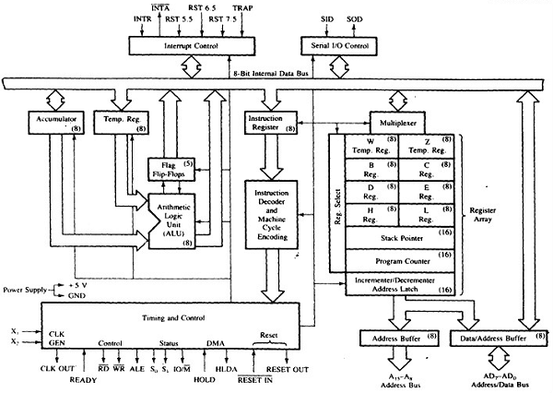
Internal details of 8085

Slide 14
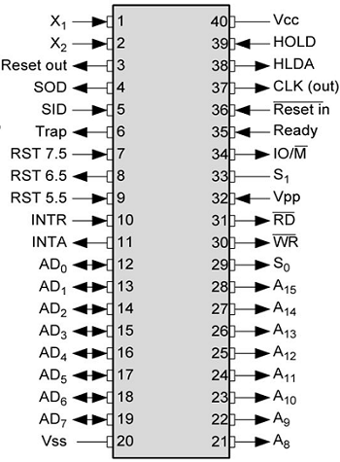
Microprocessor – 8085 Pin Configuration

Slide 15
The pins of a 8085 microprocessor can be classified into seven groups −
Address bus
A15-A8, it carries the most significant 8-bits of memory/IO address.
Data bus
AD7-AD0, it carries the least significant 8-bit address and data bus.
Control and status signals
These signals are used to identify the nature of operation. There are 3 control signal and 3 status signals.
Three control signals are RD, WR & ALE.
RD − This signal indicates that the selected IO or memory device is to be read and is ready for accepting data available on the data bus.
WR − This signal indicates that the data on the data bus is to be written into a selected memory or IO location.
ALE − It is a positive going pulse generated when a new operation is started by the microprocessor. When the pulse goes high, it indicates address. When the pulse goes down it indicates data.

Slide 16
Three status signals are IO/M, S0 & S1.
IO/M - This signal is used to differentiate between IO and Memory operations, i.e. when it is high indicates IO operation and when it is low then it indicates memory operation.
S1 & S0 - These signals are used to identify the type of current operation.
Power supply - There are 2 power supply signals − VCC & VSS. VCC indicates +5v power supply and VSS indicates ground signal.
Clock signals - There are 3 clock signals, i.e. X1, X2, CLK OUT.
X1, X2 − A crystal (RC, LC N/W) is connected at these two pins and is used to set frequency of the internal clock generator. This frequency is internally divided by 2.
CLK OUT − This signal is used as the system clock for devices connected with the microprocessor.

Slide 17
Interrupts & externally initiated signals
Interrupts are the signals generated by external devices to request the microprocessor to perform a task. There are 5 interrupt signals, i.e. TRAP, RST 7.5, RST 6.5, RST 5.5, and INTR. We will discuss interrupts in detail in interrupts section.
INTA − It is an interrupt acknowledgment signal.
RESET IN − This signal is used to reset the microprocessor by setting the program counter to zero.
RESET OUT − This signal is used to reset all the connected devices when the microprocessor is reset.
READY − This signal indicates that the device is ready to send or receive data. If READY is low, then the CPU has to wait for READY to go high.
HOLD − This signal indicates that another master is requesting the use of the address and data buses.
HLDA (HOLD Acknowledge) − It indicates that the CPU has received the HOLD request and it will relinquish the bus in the next clock cycle. HLDA is set to low after the HOLD signal is removed.

Slide 18
Serial I/O signals
There are 2 serial signals, i.e. SID and SOD and these signals are used for serial communication.
SOD (Serial output data line) − The output SOD is set/reset as specified by the SIM instruction.
SID (Serial input data line) − The data on this line is loaded into accumulator whenever a RIM instruction is executed.

Slide 19
Addressing Modes in 8085
These are the instructions used to transfer the data from one register to another register, from the memory to the register, and from the register to the memory without any alteration in the content. Addressing modes in 8085 is classified into 5 groups −
Immediate addressing mode - In this mode, the 8/16-bit data is specified in the instruction itself as one of its operand. For example: MVI K, 20F: means 20F is copied into register K.
Register addressing mode - In this mode, the data is copied from one register to another. For example: MOV K, B: means data in register B is copied to register K.
Direct addressing mode - In this mode, the data is directly copied from the given address to the register. For example: LDB 5000K: means the data at address 5000K is copied to register B.
Indirect addressing mode - In this mode, the data is transferred from one register to another by using the address pointed by the register. For example: MOV K, B: means data is transferred from the memory address pointed by the register to the register K.
Implied addressing mode - This mode doesn’t require any operand; the data is specified by the opcode itself. For example: CMP.

Slide 20
Interrupts in 8085
Interrupts are the signals generated by the external devices to request the microprocessor to perform a task. There are 5 interrupt signals, i.e. TRAP, RST 7.5, RST 6.5, RST 5.5, and INTR.
Interrupt are classified into following groups based on their parameter −
Vector interrupt − In this type of interrupt, the interrupt address is known to the processor. For example: RST7.5, RST6.5, RST5.5, TRAP.
Non-Vector interrupt − In this type of interrupt, the interrupt address is not known to the processor so, the interrupt address needs to be sent externally by the device to perform interrupts. For example: INTR.
Maskable interrupt − In this type of interrupt, we can disable the interrupt by writing some instructions into the program. For example: RST7.5, RST6.5, RST5.5.
Non-Maskable interrupt − In this type of interrupt, we cannot disable the interrupt by writing some instructions into the program. For example: TRAP.
Software interrupt − In this type of interrupt, the programmer has to add the instructions into the program to execute the interrupt. There are 8 software interrupts in 8085, i.e. RST0, RST1, RST2, RST3, RST4, RST5, RST6, and RST7.
Hardware interrupt − There are 5 interrupt pins in 8085 used as hardware interrupts, i.e. TRAP, RST7.5, RST6.5, RST5.5, INTA.

Slide 21
Interrupt Service Routine (ISR)
A small program or a routine that when executed, services the corresponding interrupting source is called an ISR.
TRAP - It is a non-maskable interrupt, having the highest priority among all interrupts. By default, it is enabled until it gets acknowledged. In case of failure, it executes as ISR and sends the data to backup memory. This interrupt transfers the control to the location 0024H.
RST7.5 - It is a maskable interrupt, having the second highest priority among all interrupts. When this interrupt is executed, the processor saves the content of the PC register into the stack and branches to 003CH address.
RST 6.5 - It is a maskable interrupt, having the third highest priority among all interrupts. When this interrupt is executed, the processor saves the content of the PC register into the stack and branches to 0034H address.
RST 5.5 - It is a maskable interrupt. When this interrupt is executed, the processor saves the content of the PC register into the stack and branches to 002CH address.

Slide 22
INTR
It is a maskable interrupt, having the lowest priority among all interrupts. It can be disabled by resetting the microprocessor.
When INTR signal goes high, the following events can occur −
The microprocessor checks the status of INTR signal during the execution of each instruction.
When the INTR signal is high, then the microprocessor completes its current instruction and sends active low interrupt acknowledge signal.
When instructions are received, then the microprocessor saves the address of the next instruction on stack and executes the received instruction.

Slide 23
Microprocessor – 8085 Instructions
Data Moving Instructions:
Control Instructions Conditional, Unconditional, Call subroutine, Return from subroutine and Restarts.
Logical Instructions AND, OR, XOR and Rotate.
Arithmetic Instructions Add, Subtract, Increment and Decrement.
Input/Output Instructions:
Others Setting/Clearing flag bits, enabling/Disabling interrupts, Stack operations etc.
Ref.:
1. Douglas V. Hall, Microprocessor and Interfacing – Programming and Hardware, 3rd Edition.
2. https://www.tutorialspoint.com/microprocessor

